Slide 1

HOTEL BOOKING ANALYSIS

Slide 2
ABOUT THE PROJECT
THIS PROJECT IS A HOTEL BOOKING ANALYSIS BASED ON THE HOTEL DATA, THE DATA IS STUDIED AND INSIGHTS ARE DRAWN FROM THE DATA ABOUT THE BOOKING STATUS, PEAK TIMES OF HOTEL BOOKING, TYPES OF GUESTS THAT VISIT THE HOTEL AND WHAT ARE THE SITUATIONS WHEN THE CUSTOMERS ARE CANCELLING THE BOOKINGS.
THIS ANALYSIS OF DATA WILL HELP THE HOTEL MANAGEMENT TO WORK ON THEIR SHORTCOMINGS AND THIS WILL DRIVE THEIR FUTURE ACTIONS.
EVENTUALLY THIS WILL HELP THEM GROW THEIR BUSINESS AND CUSTOMER SATISFCATION.

Slide 3
SKILLS USED
MICRSOFT EXCEL
POWER QUERY
PIVOT TABLES
VISUALIZATION TOOLS

Slide 4
STEPS
STEP 1: DATA CLEANING
STEP 2: PIVOT TABLES
STEP 3: DATA VISUALIZATION

Slide 5
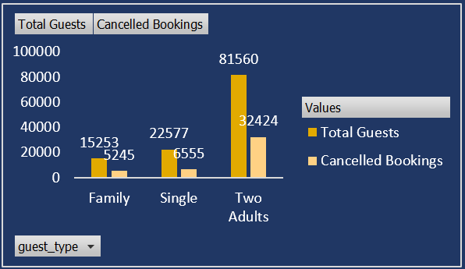
BOOKING BASED ON GUEST TYPE

Slide 6
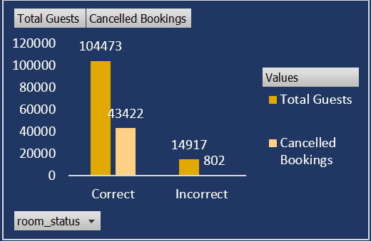
BOOKING BASED ON CORRECT AND INCORRECT ROOM ALLOTMENT

Slide 7
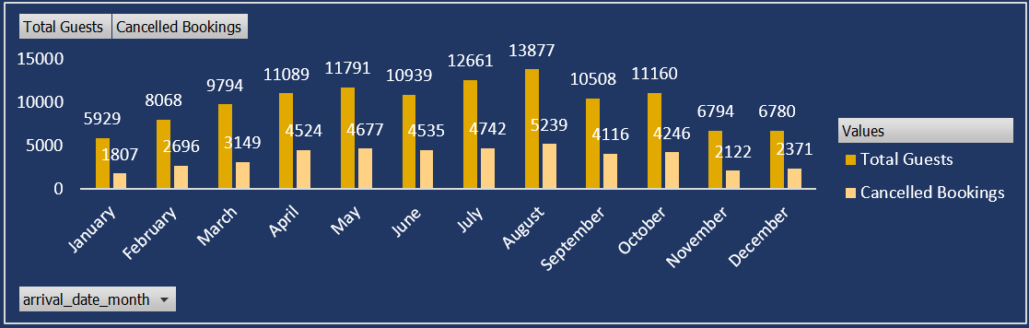
BOOKING ACCORDING T0 THE MONTH OF THE YEAR

Slide 8
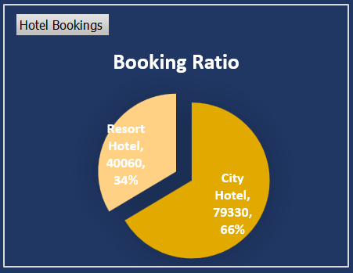
BOOKING RATIO BASED ON THE HOTEL TYPE

Slide 9
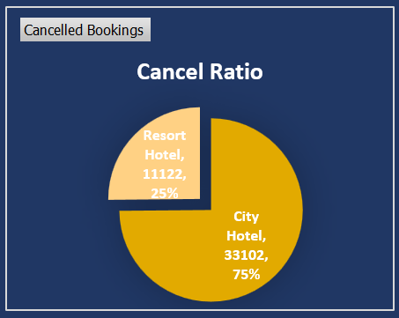
CANCELLATION RATIO BASED ON THE HOTEL TYPE

Slide 10
THANK YOU

